Slide 1
Sequential Circuits
Chapter 5

Slide 2
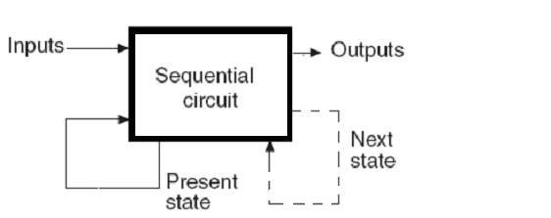
SEQUENTIAL CIRCUITS
The output is a function of the Inputs and the Present State of
the circuit
The Present State of the circuit changes to the Next State
according to the Inputs and the Present State

Slide 3
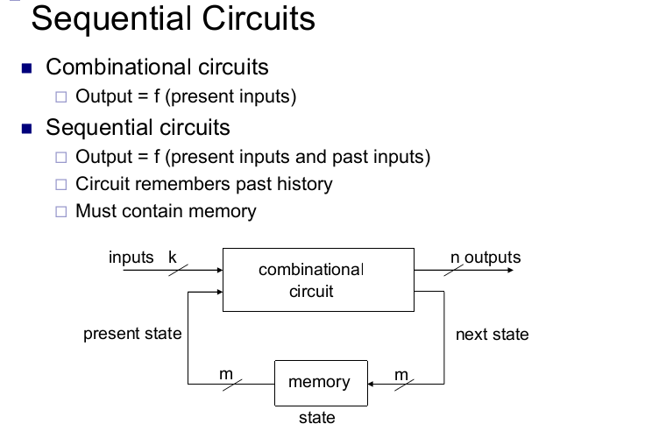

Slide 4
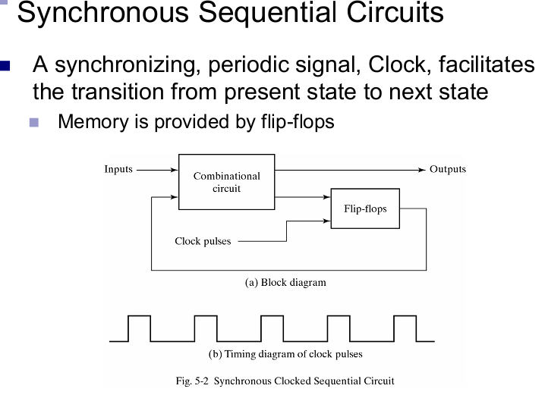

Slide 5
Latches
Latch is a circuit that has two stable states and can be used to store state information. The circuit can be made to change state by signals applied to one or more control inputs and will have one or two outputs. It is the basic storage element in sequential logic. Flip-flops and latches are a fundamental building block of digital electronics systems used in computers, communications, and many other types of systems.
Flip-flops and latches are used as data storage elements. Such data storage can be used for storage of state, and such a circuit is described as sequential logic. The output and next state depend not only on its current input, but also on its current state (and hence, previous inputs). It can also be used for counting of pulses, and for synchronizing variably-timed input signals to some reference timing signal.

Slide 6
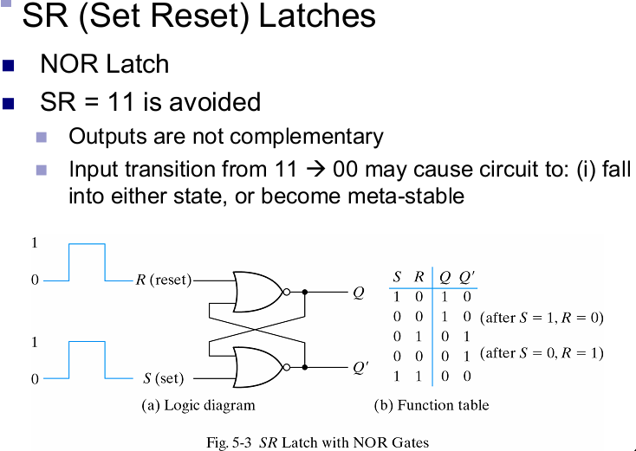

Slide 9
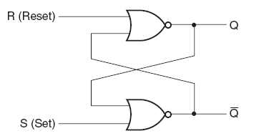
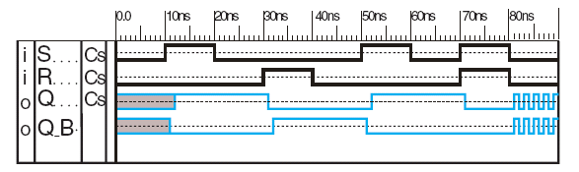
SR LATCH

Slide 10
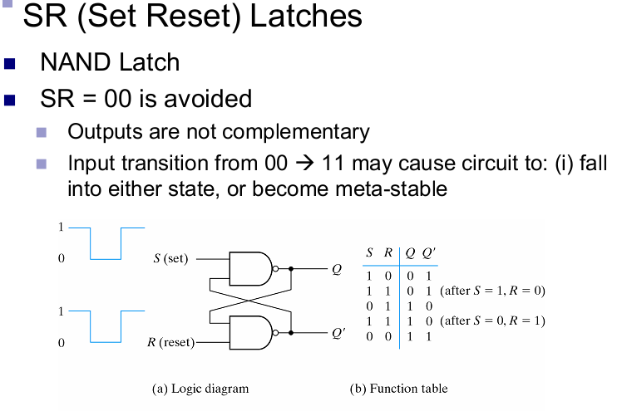

Slide 11
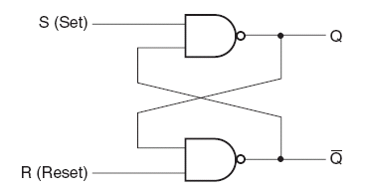
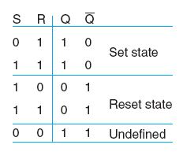
SR LATCH
S’R’ Latch with NAND Gates

Slide 12
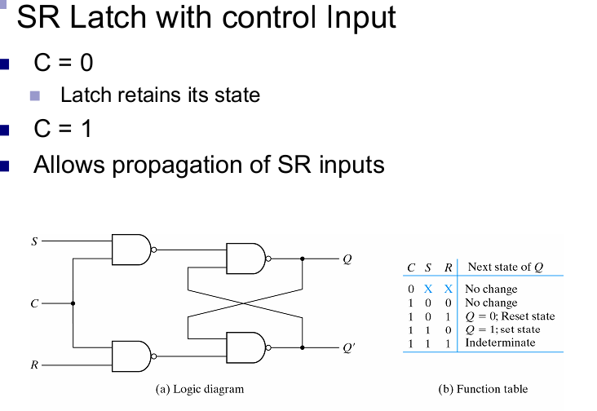
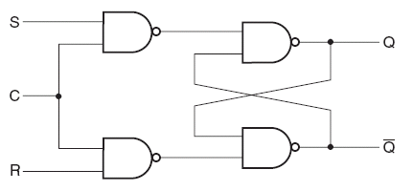
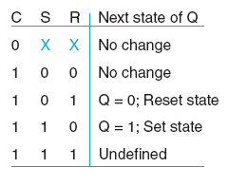
SR Latch with Control Input
Due to the first NAND gates,
the circuit again becomes an
SR latch, instead of S’R’

Slide 13
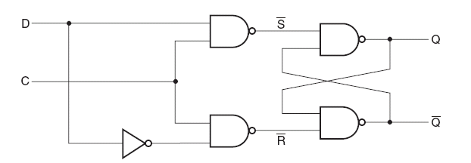
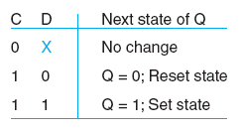
D LATCH
Called D latch because it stores a bit of data (D)
The stored data may be changed only when the control input
is “1”. When the control input is “0”, the data bit stored
is available at the output

Slide 14
FLIP FLOPS
Any change in the data input will change the state of the
latch, as long as its control input (trigger) is 1
- In other words latches are transparent (there inputs
can be seen from their outputs)
Usually the latches are connected in cascade & driven by
the same trigger
- During one trigger it is assumed that each latch will
change its state according to its current inputs
- But if the previous latch changes its state soon enough
& the trigger is still available, then the next
latch may change its state a 2nd time
In a flip flop, two latches are connected in such a way that
the input of the flip flop is not transparent from the
output

Slide 15
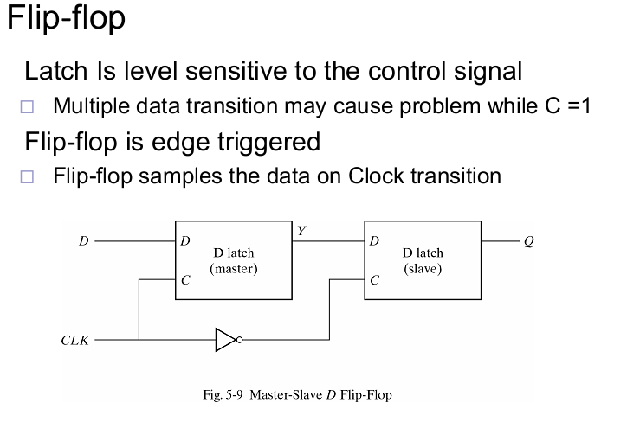
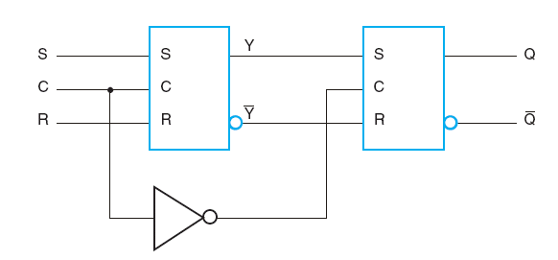
Master Slave Flip Flop

Slide 16
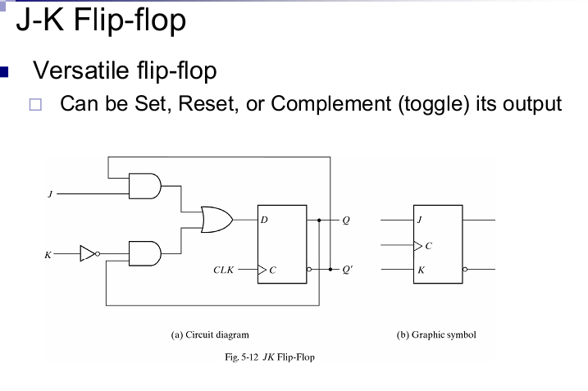
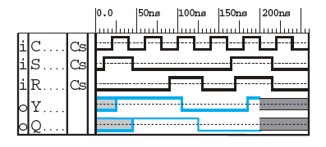
FLIP FLOPS
Master Slave Flip Flop

Slide 17
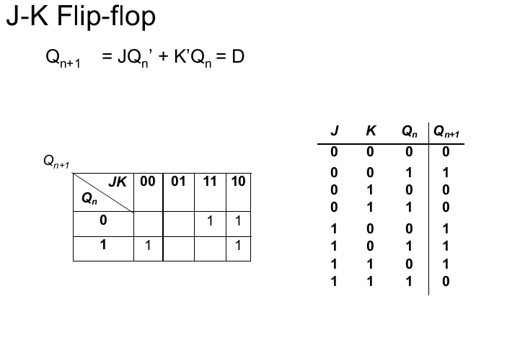

Slide 18
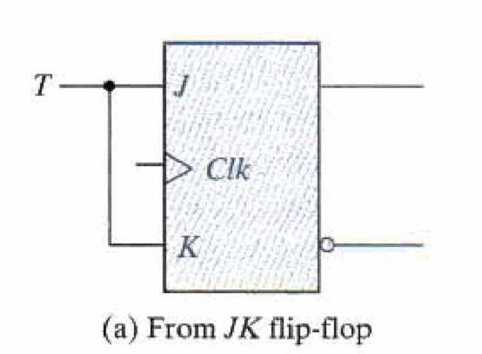
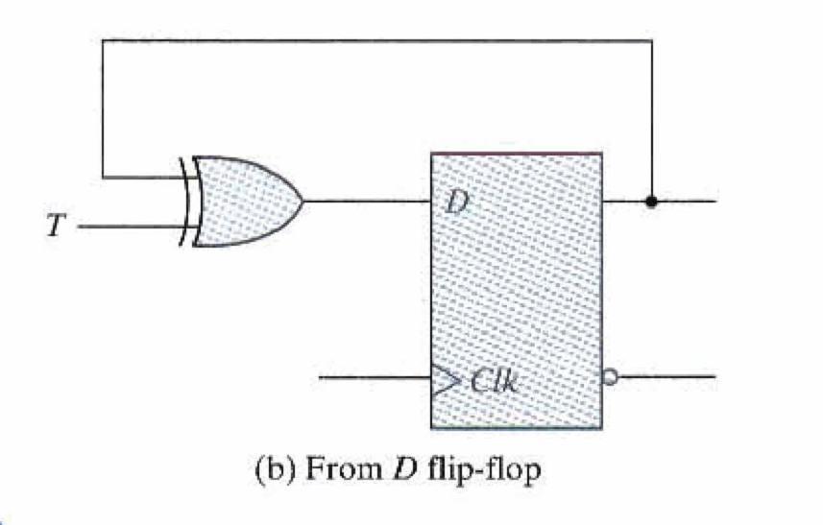
Toogle FlipFlop

Slide 19
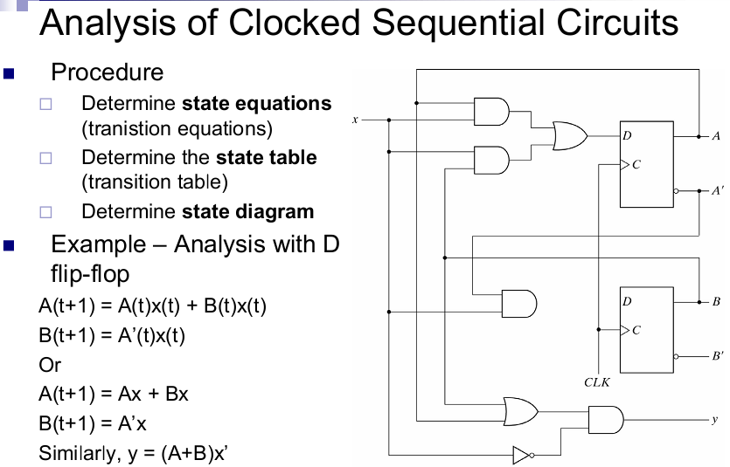

Slide 20
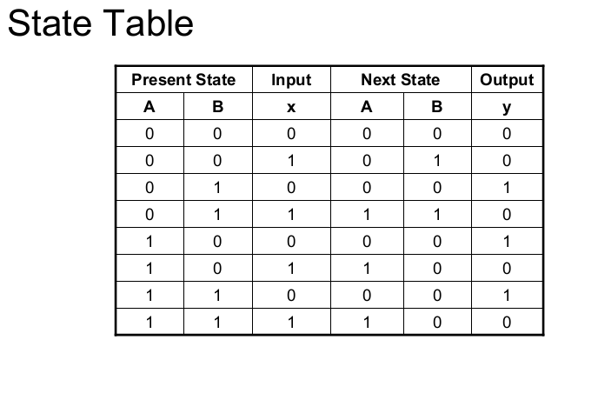

Slide 21
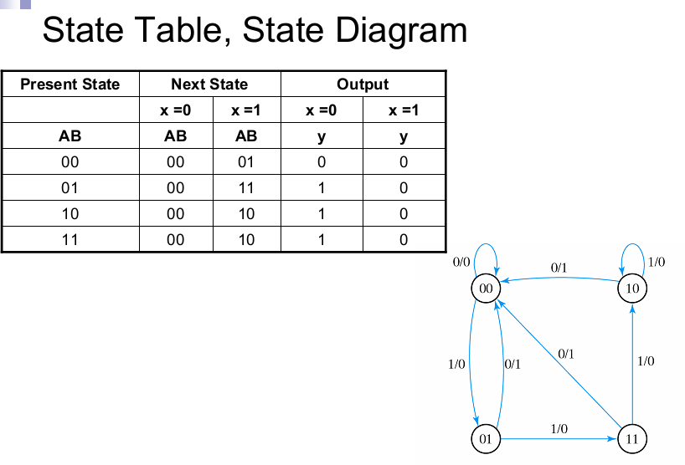

Slide 22
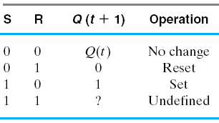
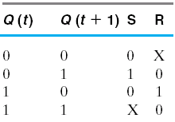
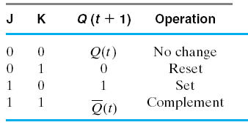
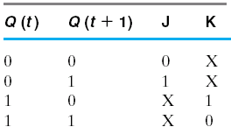
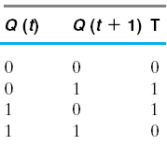
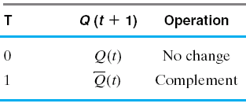
SEQUENTIAL CIRCUIT DESIGN
Excitation Tables

Slide 23
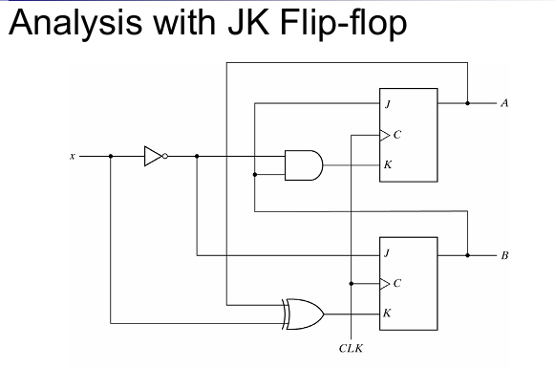

Slide 24
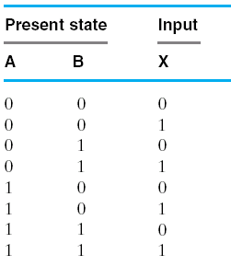

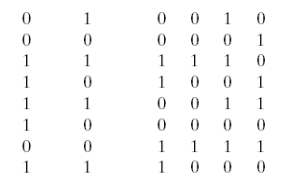
SEQUENTIAL CIRCUIT DESIGN
Example: Make the state table for the circuit with following
input equations
J_{A} = B K_{A} = BX’
J_{B} = X’ K_{B} = AX’ + A’X

Slide 25
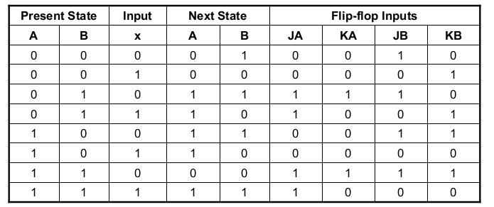
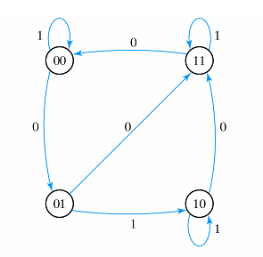

Slide 26
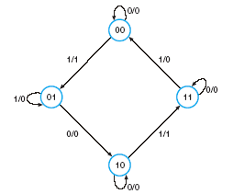
SEQUENTIAL CIRCUIT DESIGN
Example: Design the circuit with D type flip flops and then with JK
flip flops

